Slide 1
Cab Booking and Sharing Web App
Group Members : Vishal Yadav, Shubham Singh, Mihir Garg, Prateek Mishra, Rohan Srivastava

Slide 2
About the Project:
This is a web based application where anyone can book or share cabs by entering their source and destination location.
Very useful for colleges/universities in remote ares.

Slide 3
Minutes of Meetings:
We had several meetings with different college students and considered their suggestions regarding the final product. We took some of them into consideration.

Slide 4
Tools:
Specification Phase - Creately
Frontend – HTML, CSS , Javascript
Backend – PHP , MYSQL
Testing – WAPT
Text Editor – Sublime Text 3
Hosting – Xampp

Slide 5
Nature of the Customer:
Our customers are literally anyone who uses cabs to travel. It can be anyone like a student/faculty staff or a working employee in an organization. They can use this feature to share cabs among them and save some money.

Slide 6
Novelty of Project:
Our project idea is not completely unique or new but when completely established it will be one of its kind as there will be many additional features like creating a network in your organization. It will essentially be specific to one organization and will be helpful for everyone working there.

Slide 7
Sophistication value of the Project:
The project is not at all sophisticated. It is extremely simple to use and the whole interface has no complexity at all. Everything is mentioned clearly and all the fields are labeled giving the user a complete understanding of everything going on.

Slide 8
Feedback taken from the user:
We did take some feedbacks from our batchmates and most of them gave reviews like:
1. A lot of work has to be done in the user interface.
2. Many features are not currently a part of the product.
3. A lot of bugs in the whole system.
4. Only the database and back-end is working fine.

Slide 9
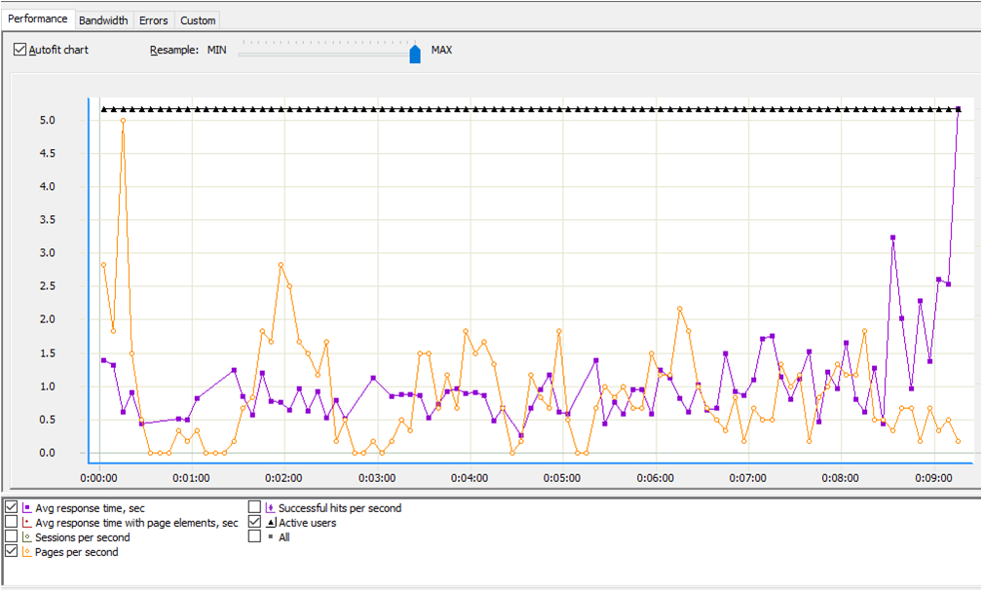
Test Results:

Slide 10
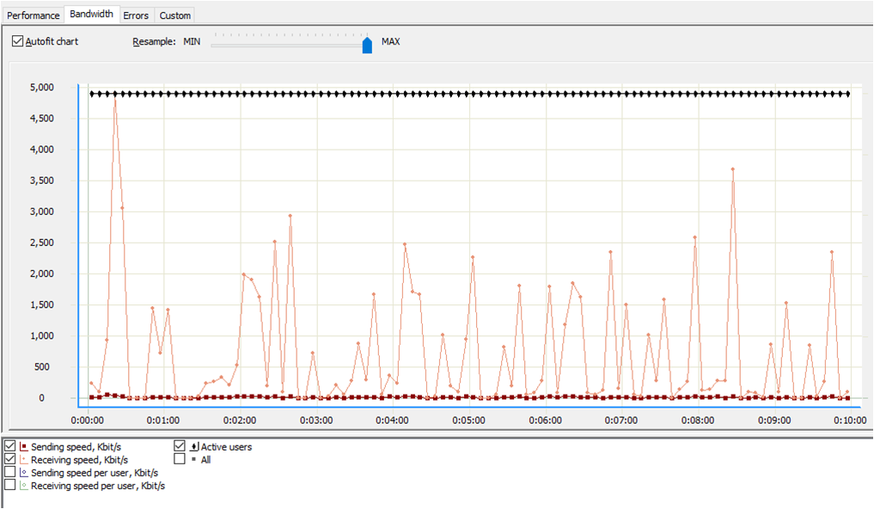
Bandwidth Test

Slide 11
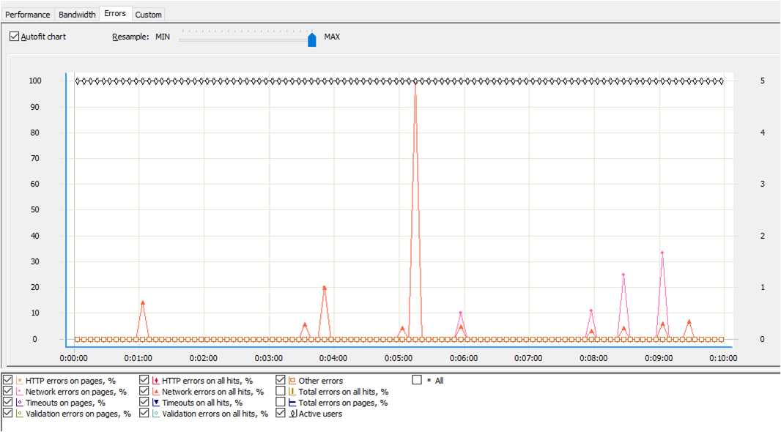
Error Report

Slide 12
Demo Time

